Slide 1
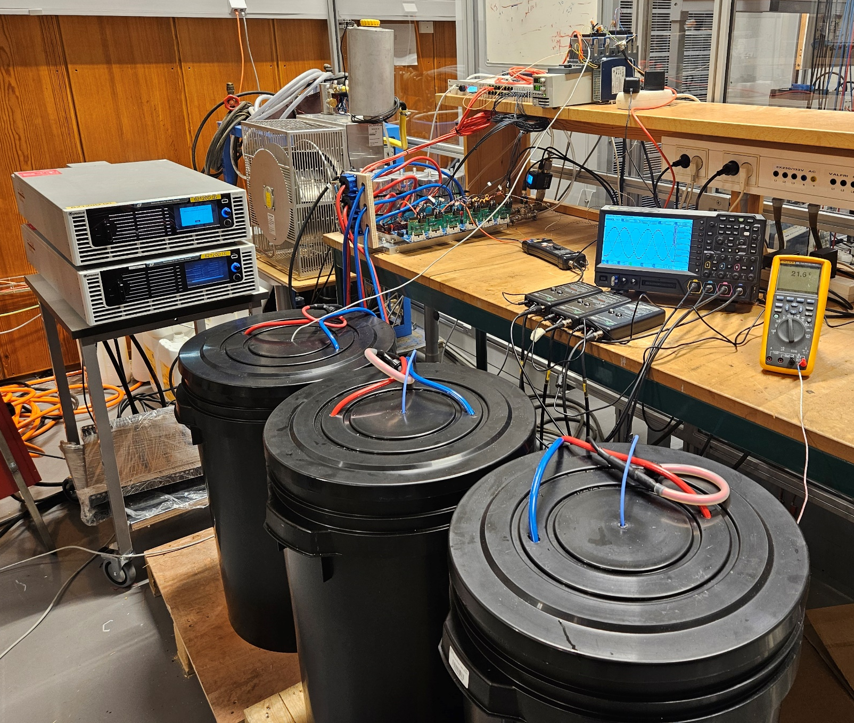
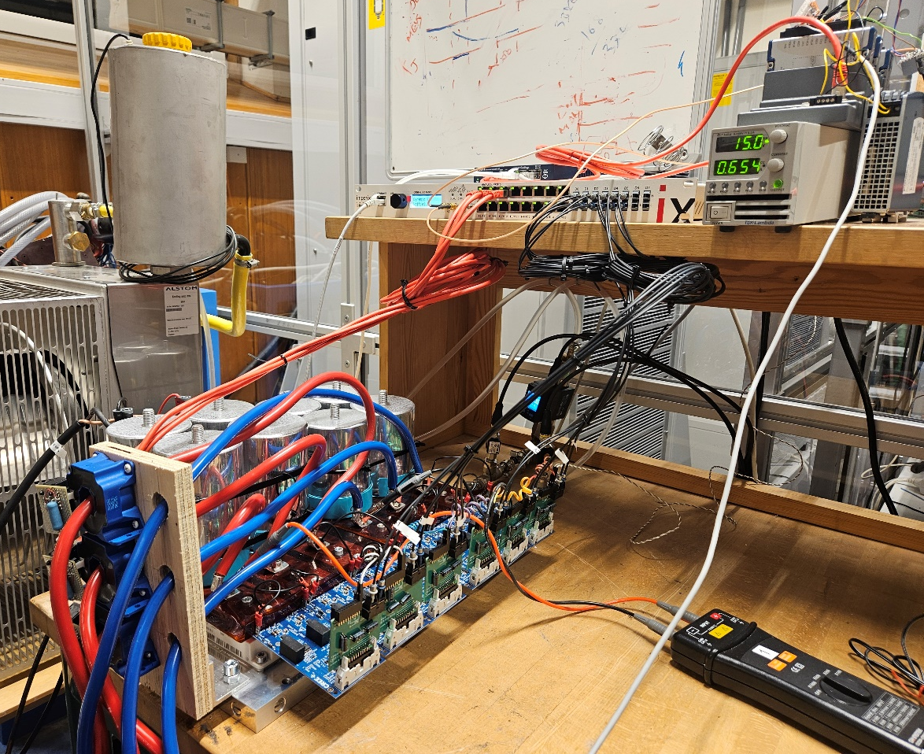
Controller
Heat Exchanger
Oscilloscope
Inverters
Power
Supply
Current Probes
Interphase Inductors
(a)
Current
Sensors
B-BOX RCP
Controller
DC-link Capacitors
Calorimetric Sensors
Gate Drives
Power Modules
(b)

